Slide 1
Antigen-Antibody Reactions
Antigens and antibodies combine with each other, specifically in an observable manner, serve several purposes:
Uses:
- In the body, they form the basis of antibody-mediated immunity in infectious diseases, or of tissue injury in some types of hypersensitivity and autoimmune diseases.

Slide 2
- In the laboratory, they help in the diagnosis of infections.
- In epidemiological surveys, they assist in the identification of infectious agents and non-infectious antigens and screening the populations for a particular infection.
- ln general, these reactions can be used for the detection and quantitation of either antigen or antibodies.

Slide 3
- Antibody reactions in vitro are known as serological reactions.
Stages :The reactions between antigens and antibodies occur in three stages:
• Primary stage: This is the initial interaction between antigens and antibodies, without any visible effects.
- This reaction is rapid, occurs even at low temperatures. The reaction is reversible .

Slide 4
- Primary reaction can be detected by estimating free and bound antigens or antibodies separately by number of physical and chemical methods, including the use of markers such as radioactive isotopes, fluorescent dyes or furritin.

Slide 5
• Secondary stage: In most, instances, the primary stage is followed by the secondary stage, leading to demonstrable events such as Precipitation, agglutination, lysis of cells, killing of live antigens, neutralisation of toxins and other biologicaliy active antigens,

Slide 6
- fixation of complement, immobilisation of motile organisms and enhancement of phagocytosis.
- the antibody causing agglutination was called agglutinin, that causing precipitation precipitin, and so on, and the corresponding antigen, agglutinogen, precipitinogen, and so on.

Slide 7
Tertiary stage: Some antigen-antibody reactions occurring in vivo initiate chain reactions that lead to neutralisation or destruction of injurious antigens, or to tissue damage. These are tertiary reactions and include humoral immunity against infectious diseases as well as clinical allergy and other immunological diseases.

Slide 8
General features of antigen-antibody reaction
1. The reaction is specific, an antigen combining only with its homologous antibody and vice versa. The specificity, however, is not absolute and cross reactions may occur due to antigenic similarity or relatedness .

Slide 9
2. Entire molecules, and not fragments, react. When an antigenic determinant present in a large molecule or on a carrier particle reacts with its antibody, whole molecules or particles are agglutinated.
3. There is no denaturation of the antigen or the antibody during the reaction.

Slide 10
4. The combination occurs at the surface. it is the surface antigens that are immunologically relevant. Antibodies to the surface antigens of infectious agents are generally protective.
5. The combination is firm but reversible. The firmness of the union is influenced by the affinity and avidity of the reaction:

Slide 11
• Affinity : refers to the intensity of attraction between the antigen and antibody molecules. It is a function of the closeness of fit between an epitope and the antigen combining region of its antibody (paratope).
- Affinity is a quantitative measure of binding strength between an antibody and an epitope. Low-affinity antibodies bind antigens weakly and tend to dissociate readily. whereas high-affinity antibodies bind antigens more tightly and remain bound longer .

Slide 12
• Avidity : is the strength of the bond after the formation of the antigen-antibody complexes and is a better measure of its binding capacity within biological systems (for example, the reaction of an antibody with antigenic determinants on a virus , or bacterial cell) than the affinity of its individual binding sites.

Slide 13
6. Both antigens and antibodies participate in the formation of agglutinates or precipitates.
7. Antigens and antibodies can combine in varying proportions. Both antigens and antibodies are multivalent. Antibodies are generally bivalent.
- IgM molecule may have five or ten combining sites . Antigens may have valencies up to the hundreds .

Slide 14
Measurement of antigen and antibody :
Many methods are available for the measurement of the antigens and antibodies participating in the primary, secondary and tertiary reactions.
- Measurement may be in terms of mass (for example, mg nitrogen) or as units or titre.
- The antibody titre of a serum is the highest dilution of the serum that shows an observable reaction with the antigen in the particular test.

Slide 15
- The titre of a serum is influenced by the nature and quantity of the antigen and the type and conditions of the test. Antigens may also be titrated against sera.
Two important parameters of serological tests are sensitivity and specificity:
• Sensitivity - refers to the ability of the test to detect even very minute quantities of antigen or antibody. When a test is highly sensitive, false negative results will be absent or minimal.

Slide 16
• Specificity - refers to the ability of the test to detect reactions between homologous antigens and antibodies only, and with no other .
- In a highly specific test, false positive reactions are absent or minimal.
- In general, the sensitivity and specificity of a test are in inverse proportion.

Slide 17
- Originally, reagents for serological tests were prepared by individual laboratories, leading to batch variation , and lack of reproducibility and comparability.
- The commercial availability of readymade standardised test kits has simplified test procedures, improved quality and greatly enlarged their scope and use.

Slide 18
SEROLOGICAL REACTIONS
PRECIPITATION REACTION :
Precipitation: When a soluble antigen combines with its antibody in the presence of electrolytes (NaCl) at a suitable temperature and pH, the antigen-antibody complex forms an insoluble precipitate.

Slide 19
Flocculation: When, instead of sedimenting, the precipitate remains suspended as floccules, the reaction is known as flocculation.
Precipitation can take place in liquid media or in gels such as agar, agarose or polyacrylamide.
Phases: The amount of precipitate formed is greatly influenced by the relative proportions of antigens and antibodies.

Slide 20
If Increasing quantities of antigens are added to the same amount of antiserum in different tubes, precipitation will be found to occur most rapidly and abundantly in one of the middle tubes in which the antigen and antibody are present in optimal or equivalent proportions.
In the preceding tubes in which the antibody is in excess and in the later tubes in which the antigen is in excess, the precipitation will be weak or even absent.

Slide 21
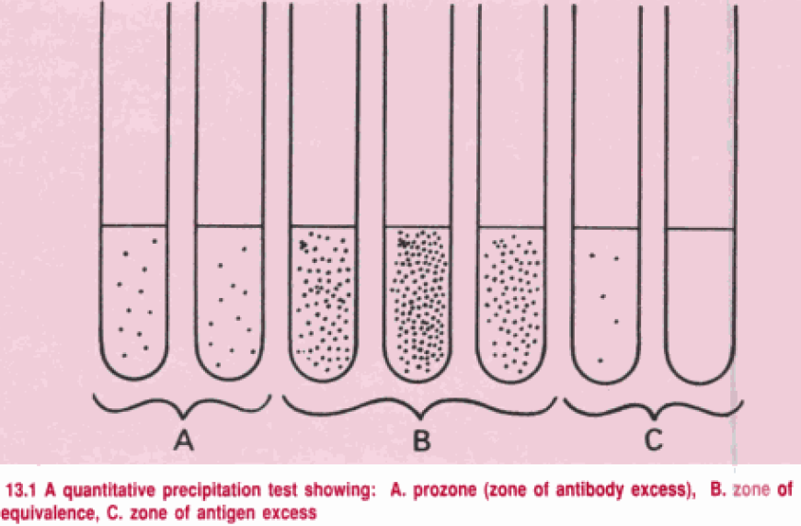

Slide 22
For a given antigen-antibody system, the optimal or equivalent ratio will be constant, irrespective of the quantity of the reactants.
If the amounts of precipitate in the different tubes are plotted on a graph, the resulting curve will have three phases:

Slide 23
1. Prozone phenomenon: This is caused by excess antibody in the test system. Failure of a visible reaction is due to inhibition of lattice formation by the excess antibody.
2. Zone of equivalence: Here, the antigen and antibody are in optimum proportions. Lattice formation and visible reactions are enhanced.
3. Post-zone phenomenon: This is caused by the presence of excess antigen in the test system. No visible reaction will occur.

Slide 24
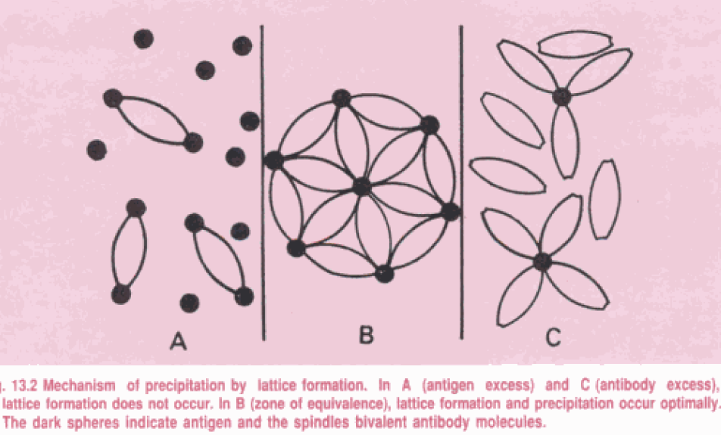

Slide 25
The prozone is of importance in clinical serology, as sera rich in antibody will sometimes give a false negative precipitation or agglutination result, unless several dilutions are tested.

Slide 26
Mechanism of precipitation
- Marrack (1934) proposed the lattice hypothesis to explain the mechanism of precipitation.
- According to this concept, multivalent antigens combine with bivalent antibodies in varying proportions, depending on the antigen-antibody ratio in the reacting mixture.

Slide 27
- Precipitation results when a large lattice is formed consisting of alternating antigen and antibody molecules. This is possible only in the zone of equivalence.
- In the zones of antigen or antibody excess, the lattice does not enlarge, as the valencies of the antibody and the antigen, are fully satisfied. (Fig.)

Slide 28
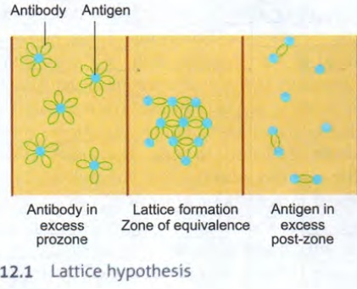

Slide 29
Applications :
The precipitation test may be carried out as a qualitative or quantitative test. It is sensitive in the detection of antigens and as little as 1μg of protein can be detected.
- It is relatively less sensitive for the detection of antibodies.

Slide 30
- Precipitation tests have several applications :
forensic application in the identification of blood and seminal stains.
Testing for food adulterants
Grouping of streptococci by the Lancefield technique
The VDRL test for syphilis
To standardise toxins and toxoids
To test toxigenicity in diphtheria bacilli

Slide 31
The following types of precipitation and flocculation tests are in common use:
Ring test:
This is the simplest type of precipitation test, consists of layering the antigen solution over a column of antiserum in a narrow tube. A precipitate forms at the junction of the two Liquids. Examples are Ascoli's thermoprecipitin test and the grouping of streptococci by the Lancefield technique.

Slide 32
Slide test :
- When a drop of antigen and the antiserum are placed on a slide and mixed by shaking, floccules appear. VDRL test for syphilis is an example of slide flocculation.
Tube test :
  Kahn test for syphilis is an example of a tube flocculation test.
  A quantitative tube flocculation test is used for the standardisation of toxins and toxoids.

Slide 33
  - Serial dilutions of the toxin/ toxoid are added to the tubes containing a fix quantity of the antitoxin. The amount of toxin or toxoid that flocculates optimally with one unit of the antitoxin is defined as an Lf dose.
Immunodiffusion (precipitation in gel) :
- Several advantages of precipitation in gel over liquid medium. The reaction is visible as a distinct band of precipitation, which is stable and can be stained for preservation.

Slide 34
- Each antigen-antibody reaction gives rise to a line of precipitation, so the number of different antigens in the reacting mixture can be observed.
- Immunodiffusion also indicates identity, cross-reaction and non-identity between different antigens.
- Immunodiffusion is usually performed in a soft (1 %)agar or agarose gel.

Slide 35
Modifications of the immunodiffusion test :
1. Single diffusion in one dimension (Oudin procedure):
- The antibody is incorporated in agar gel, in a test tube and the antigen solution is layered over it.
- The antigen diffuses downward through the agar gel, forming a line of precipitation that appears to move downwards.
- The number of bands indicates the number of different antigens present.

Slide 36
2. Double diffusion in one dimension (Oakley - Fulthorpe procedure):
- Here, the antibody is incorporated in gel, above which is placed a column of Plain agar. The antigen is layered on top of this. The antigen and antibody move towards each other through the intervening column of plain agar and form a band of precipitate where they meet at optimum proportion. (Fig.)

Slide 37
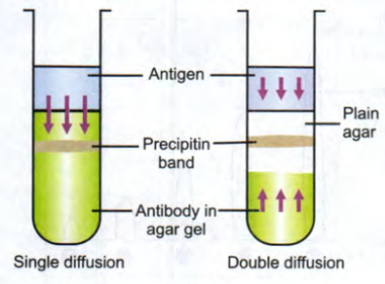

Slide 38
3. Single diffusion in two dimensions (Radial immunodiffusion) :
- Here, the antiserum is incorporated in agar gel poured on a flat surface (slide or petridish). The antigen is added to the wells cut on the surface of the gel.
- It diffuses radially from the well and forms ring-shaped bands of precipitation (halos) concentrically around the well.

Slide 39
- The diameter of the halos gives an estimate of the concentration of the antigen.
- This method has been used for the estimation of the immunoglobulin classes in sera and for screening sera for antibodies to influenza viruses, among others (Fig.)

Slide 40
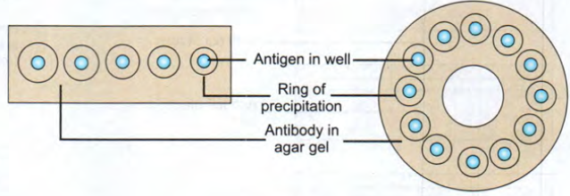
Single diffusion in two dimensions

Slide 41
4. Double diffusion in two dimensions (Ouchterlony procedure) :
- This method is most widely employed and helps to compare different antigens and antisera directly.
- Agar gel is poured on a slide and wells are cut using a template. The antiserum is placed in the central well , and different antigens in the surrounding wells.

Slide 42
- If two adjacent antigens are identical, the lines of precipitate formed by them will fuse .
- If they are unrelated, the lines will cross each other. Cross reaction or partial identity is indicated by spur formation. e.g Elek test for toxigenicity in diphtheria bacilli. (Fig.)

Slide 43
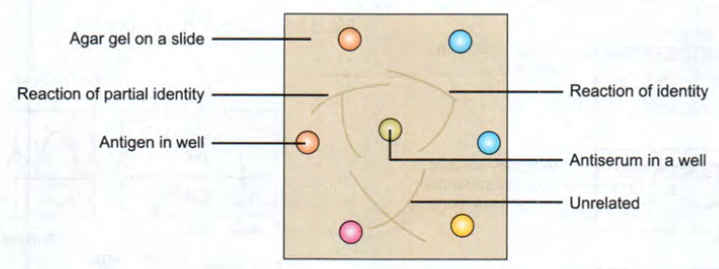
Double diffusion in Two Dimensions

Slide 44
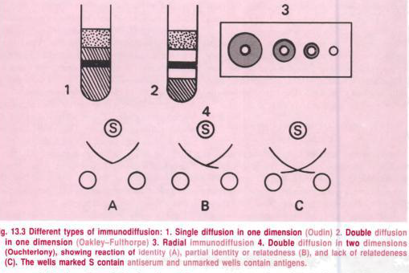

Slide 45
5. Immunoelectrophoresis:
- The resolving power of immunodiffusion was greatly enhanced by immunoelectrophoresis was devised by Grabar and Williams.
- This involves the electrophoretic separation of a composite antigen (such as serum) into its constituent proteins, followed by immunodiffusion against its antiserum, resulting in separate precipitin lines, indicating reaction between each individual protein with its antibody.

Slide 46
- This enables identification and approximate quantitation of the various proteins present in the serum.
- The technique is performed on agar or agarose gel on a slide, with an antigen well and an antibody trough cut on it.
- The test serum is placed in the antigen well and electrophoresed for about an hour.

Slide 47
- Antibody against human serum is then placed in the trough and diffusion allowed to proceed for 18-24 hours. The resulting precipitin lines can be photographed and the slides dried, stained and preserved for record .
- Over 30 different proteins can be identified by this method in human serum. This is useful for testing for normal and abnormal proteins in serum and urine. (Fig.)

Slide 48
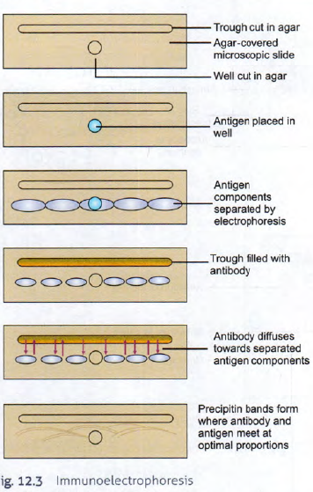

Slide 49
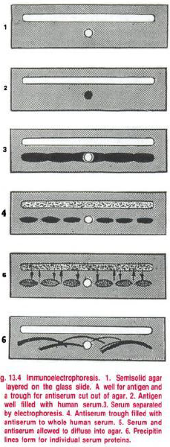

Slide 50
Electroimmunodiffusion:
- The development of precipitin lines can be speeded up by electrically driving the antigen and antibody with diffusion using various methods.
Counterimmunoelectrophoresis (CIE, countercurrent mmunoelectrophoresis):
- This involves simultaneous electrophoresis of the antigen and antibody in gel in opposite directions , resulting in precipitation at a point between them (Fig.).

Slide 51
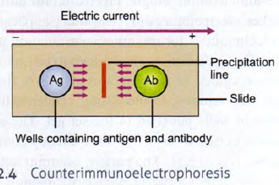
- This method produces visible precipitation lines within 30 minutes and is ten times more sensitive than the standard double diffusion techniques.

Slide 52
One-dimensional single electroimmuno-diffusion (rocket electrophoresis):
- The main application is for quantitative estimation of antigens.
- The antiserum to the antigen to be quantitated is incorporated in agarose and gelled on the glass slide. The antigen, in increasing concentrations, is placed in wells punched in the set gel.

Slide 53
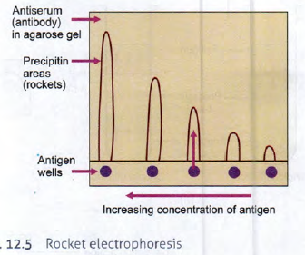
- The antigen is then electrophoresed into the antibody containing agarose (Fig. ). The pattern of immuno-precipitation resembles a rocket.

Slide 54
Two-dimensional electrophoresis:
- In Laurell’s two dimensional electrophoresis, the antigen mixture is first electrophoretically separated in a direction perpendicular to that of the final rocket stage.
- By this method, one can quantitate each of several antigens in a mixture (Fig.).

Slide 55
